Slide 1
Operating system and system programming (25CS2104E)
TITLE
Review-I
Under the Esteemed Guidance of
Raghupathi M
CSE Department
Team Members:
Name- Roll Number

Slide 2
Contents
Abstract
Introduction
Hardware and Software requirements
System Architecture
Conclusion

Slide 3
Abstract
The Virtual Memory Page Replacement Visualizer is an Operating Systems and System Programming (OSSP) project developed using the C programming language on Ubuntu Linux. The main objective of this project is to demonstrate how operating systems manage memory when the available physical memory frames are limited. It implements three page replacement algorithms: First-In, First-Out (FIFO), Least Recently Used (LRU), and Optimal Page Replacement. The system displays memory frame contents step by step and identifies page hits and page faults for each page reference. It also calculates hit ratios and page fault ratios and compares the performance of all three algorithms using the same input sequence. This project helps students understand virtual memory management, page replacement strategies, and memory utilization. It provides a simple, interactive, and practical way to learn fundamental operating system concepts through simulation.

Slide 4
Introduction
Virtual memory is an essential concept in operating systems that allows programs to execute efficiently even when physical memory (RAM) is limited. It divides memory into fixed-size units called pages, which are loaded into physical memory frames when required. When all available frames are occupied and a new page needs to be loaded, the operating system must select an existing page for replacement. This process is known as page replacement.The Virtual Memory Page Replacement Visualizer is a C-based project developed on Ubuntu Linux to demonstrate this process through simulation. It implements three popular page replacement algorithms: FIFO (First-In, First-Out), LRU (Least Recently Used), and Optimal Page Replacement. The project displays frame contents, identifies page hits and page faults, calculates performance ratios, and compares the algorithms. It provides a practical learning tool for understanding memory management, analyzing algorithm efficiency, and exploring fundamental operating system concepts.

Slide 5
Hardware and Software requirements
Hardware requirements
S. No. | Component | Minimum requirement
1 | Processor | Intel Core i3 or equivalent
2 | RAM | 4 GB
3 | Storage | 500 MB free space
4 | System | Desktop or laptop
5 | Input devices | Keyboard and mouse

Slide 6
Software requirements
S. No. | Software | Requirement
1 | Operating System | Ubuntu Linux
2 | Programming Language | C
3 | Compiler | GCC
4 | Code Editor | Visual Studio Code or Nano
5 | Version Control | Git
6 | Repository Hosting | GitHub
7 | Terminal | Ubuntu Terminal

Slide 7
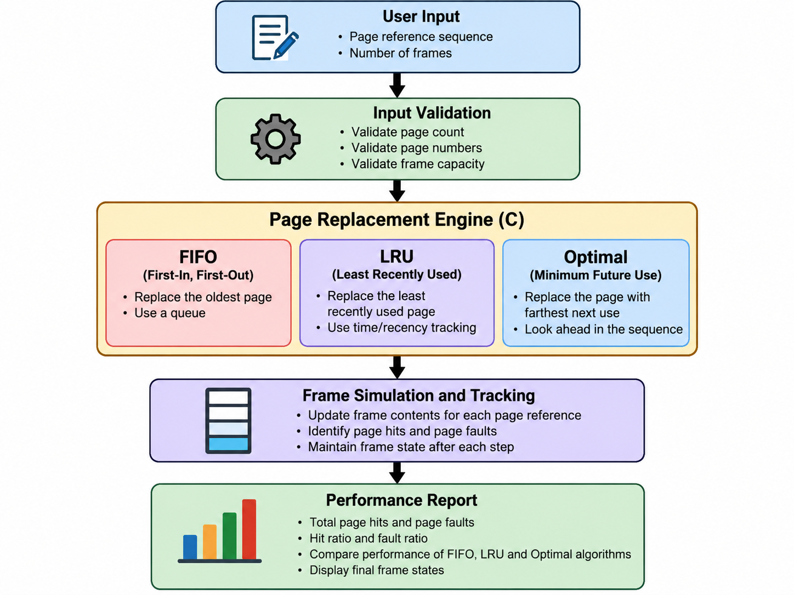
System Architecture

Slide 8
Thank you

